Slide 1
Name, Date
© Copyright 2012 by Pacific Biosciences of California, Inc. All rights reserved.

Slide 2
Assessing and Troubleshooting Data Pre-Alignment Using stsPlots.2.0.R

Slide 3



Learning Objectives
Target Audience
Scientists and Bioinformaticians:
Familiar with bioinformatics concepts
Interested in learning to evaluate and troubleshoot data from PacBio® RS runs.
Skills Learned
After the training, you will be able to:
Use the sts.csv file to assess RS run quality.
Distinguish among several possible causes of poor run quality.
Prerequisite
SMRT Technology
PacBio RS Workflow
Notes:
The target audience for this module includes scientists and bioinformaticians who are interested in understanding the secondary analysis pipeline and algorithms. After completing this module, you will be able to outline and describe the key elements of secondary analysis pipeline for single molecule real time sequencing with the PacBio RS. It is recommended that you review this training module after the introductory training modules on Bioinformatics Overview and Primary Analysis.

Slide 4
StsPlots Tool: Quickly Evaluate Data Quality After Primary Analysis Finishes.
Information from the sts.csv file, generated after primary analysis completes, is plotted using R. (R is free statistics and graphing software which runs on any platform.)
The plots allow the user to assess chip loading, readlength, read score, SNR, and oxygen exclusion.
No reference genome is required.
No sequence information is accessed.
The plots render very quickly, allowing for rapid assessment of run quality, making it especially useful for reviewing a loading titration experiment before launching a longer run.

Slide 5
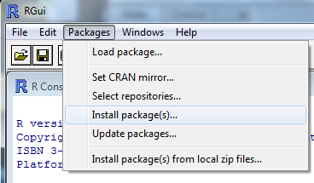
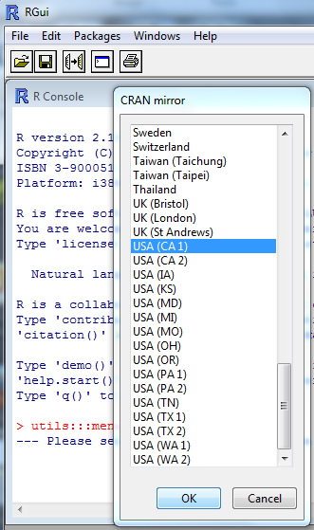
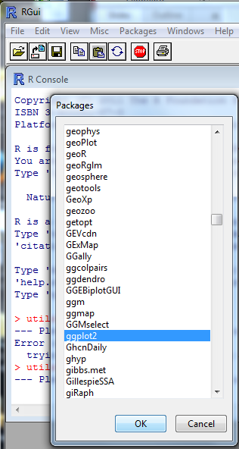
Using StsPlots : Install the Required Software
Download and install the most recent version of R on your laptop. (2.15.0)
http://www.r-project.org/
Open R and install the packages required to run stsPlots.batch.R (ggplot2, plyr, and reshape2).
Get stsPlots.2.0.R
and put it in a folder under
My Documents.
1
2
3

Slide 6
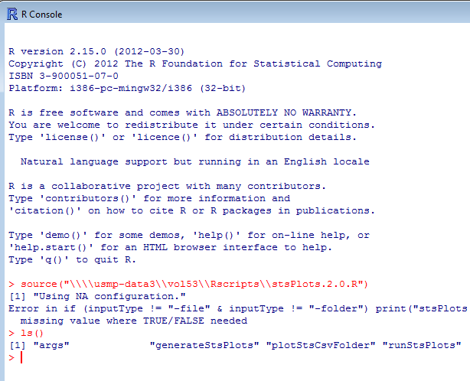
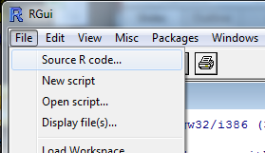
Running the Script
Collect all the sts.csv files to be processed in one folder, also under your My Documents folder.
In R, source the stsPlots.2.0.R script. Type ls() to check that the functions in the script have loaded successfully into your workspace. The output should look like the image below.
2
1

Slide 7
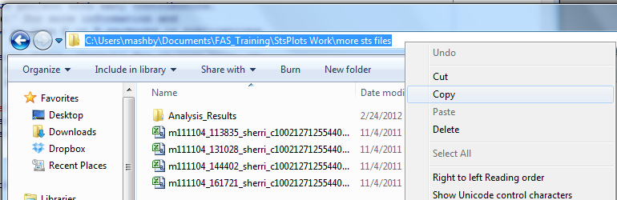
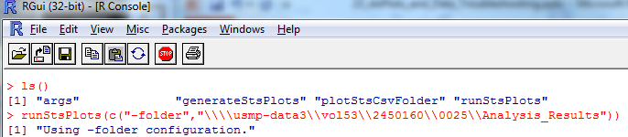
Running the script on a folder of sts.csv files from the R interpreter
Navigate to the folder with the sts.csv files. Click on the navigation bar to reveal the path and copy it.
In R, use the runStsPlots function with the “-folder” flag to run the analysis for all sts.csv files a folder. Note that after pasting in the copied path, you have to enclose it in quotes and double all the backslashes.
Output pdfs will appear in a new subfolder named “Analysis_Results”.
1
3
2

Slide 8
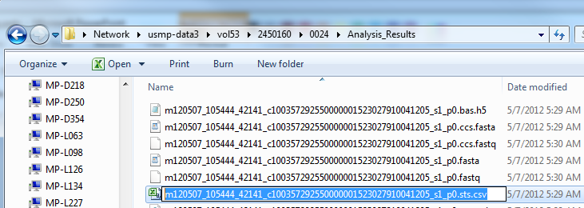
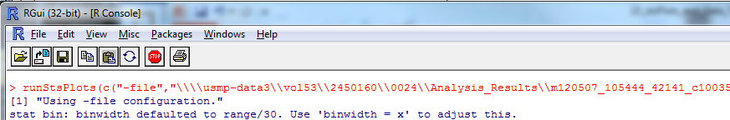
Running the script on a single file inside the R interpreter
In R, use the runStsPlots function with the “-file” flag.
Navigate to the folder with the sts.csv file. Copy the path as before, enclosing it in quotes and doubling all the backslashes. Also copy the file name and paste that onto the path to complete the filename.
The output pdf will appear the same folder.
1
2

Slide 9
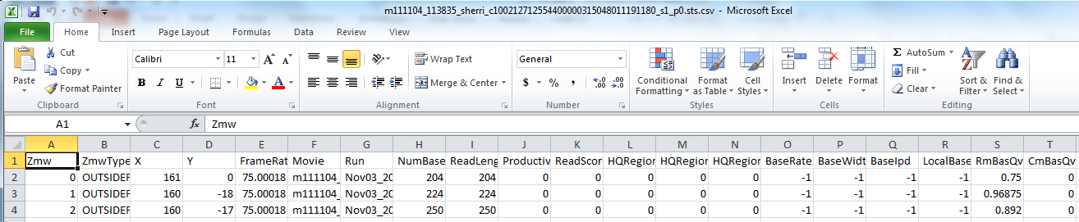
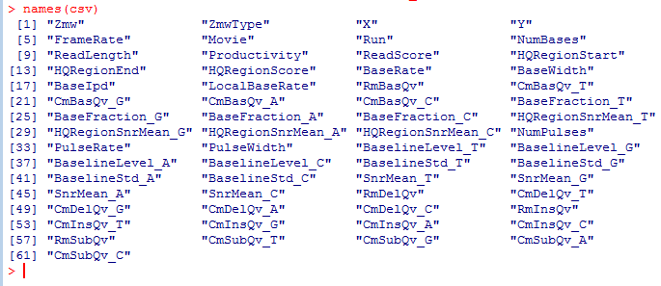
For Additional Plotting, Open the sts.csv File in Excel
Here’s all the information available in an sts.csv file (one row per ZMW):

Slide 10
Using R to Generate Additional Plots From the sts.csv File
Alternately, if you are very motivated you can learn to use R’s full analysis and graphing capabilities. Here are some links to get you started:
http://www.r-project.org/
http://www.cyclismo.org/tutorial/R/
http://www.ats.ucla.edu/stat/R/faq/
http://stat.ethz.ch/R-manual/R-devel/doc/manual/R-lang.html
http://had.co.nz/ggplot2/
http://svitsrv25.epfl.ch/R-doc/doc/html/search/SearchEngine.html
Here are some handy R commands to get you started:
df <- read.csv(“C:\\Path\\ToYour\\sts.csv”) Reads your csv file into the workspace as a dataframe.
names(df): Lists the column names in your dataframe.
levels(factor(df$columnName)): Gives all unique values in the column
table(df$columnName): Gives values in a column and #rows w/each
dim(df): Gives nRows and nColumns
head(df): Shows the first 6 lines of the dataframe
ls(): Lists all the objects in your workspace

Slide 11
Using stsPlots From the Command Line
The stsPlots.2.0.R code can be called from the command line using the “Rscript” executable included in both Windows and Linux R installations. Navigate to the folder containing the R script.
> “C:\Program Files\R\R-2.15.0\bin\Rscript.exe” --vanilla stsPlots.2.0.R -file <path to sts.csv file>
If sts.csv files are dispersed through your Linux based LIMS directory, this is an example of how you might analyze multiple sts.csv files:
$ echo /mnt/volume/run/cell/Analysis_Results/*s1_p0.sts.csv | xargs –n 1 Rscript --vanilla <path to stsPlots.2.0.R> -file
The stsPlots.2.0.R script can analyze a folder of sts.csv’s like this:
> “C:\Program Files\R\R-2.15.0\bin\Rscript.exe” --vanilla stsPlots.2.0.R -folder <path to sts.csv folder>

Slide 12
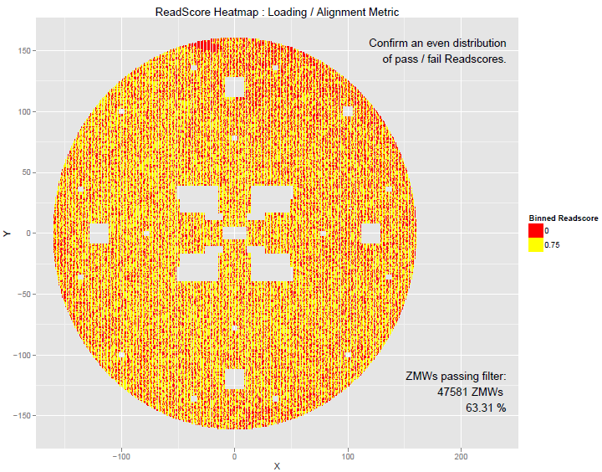
ReadScore Heatmap: Check Chip Alignment and Data Quality

Slide 13
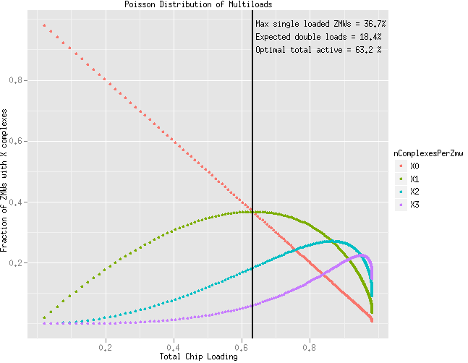
Assuming a Poisson Distribution of Loading (Caveat Emptor) Singly Loaded ZMWs are Maximized at 63% Total Active ZMWs

Slide 14
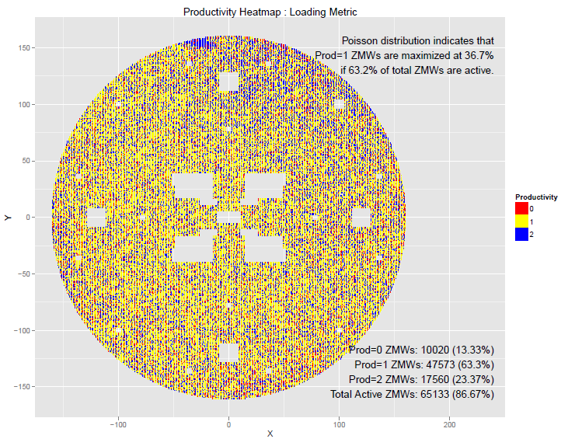
Productivity Heatmap: Check Chip Alignment and Loading
Prod=1 means the ZMW has an HQ region with > half of all bases and a Readscore > 0.75
Note that Prod=2 does not mean doubly loaded!
It means not P=0 and not P=1.

Slide 15
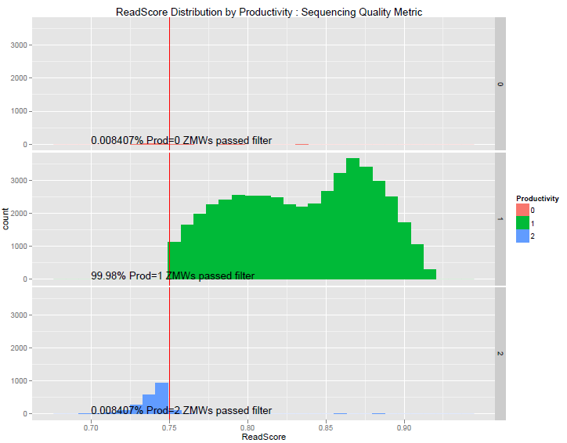
ReadScore Distribution: Check the Read Quality for Each Productivity Segment (Usually Only P=1 Passes Filtering)

Slide 16
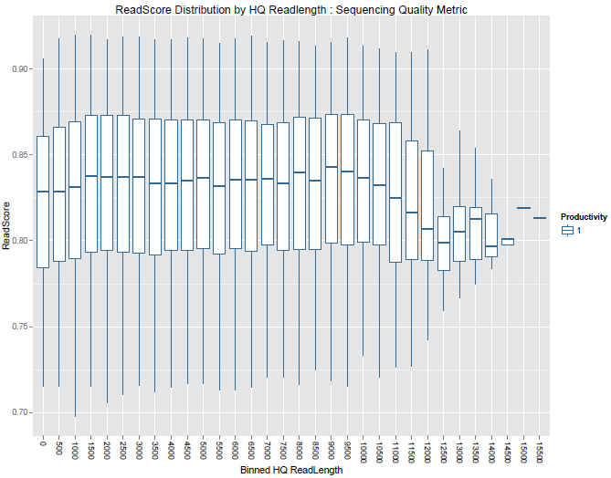
ReadScore Distribution by HQ Readlength: Read Quality Should Be Stable Across All Readlength Bins

Slide 17
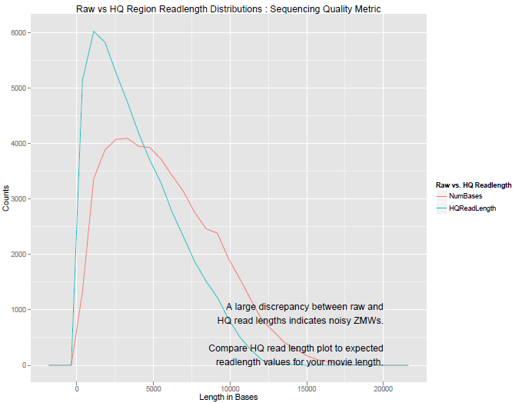
Raw vs HQ Readlength: Many Reads May Pass Filtering, But How Much are Those Reads Shortened by Filtering?
Gives a sense of how much of ZMW activity is not high quality sequencing

Slide 18
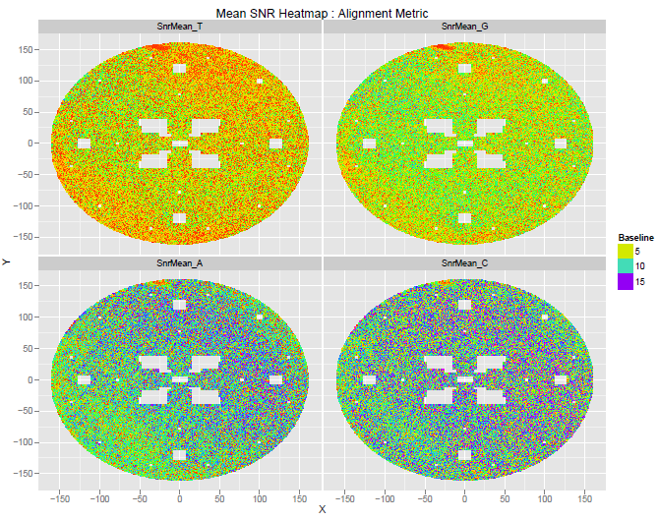
Mean SNR Heatmap: Look for Instrument Issues and Chip Alignment Quality

Slide 19
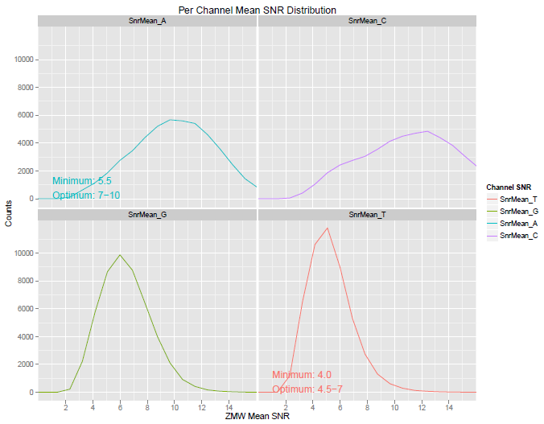
Mean per ZMW SNR Distribution, Including Performance Guidelines From SIV
Out-of-spec SNR can explain short readlengths or low accuracy, and can indicate poor chip alignment, out of spec ZMW pore size, or laser performance problems.

Slide 20
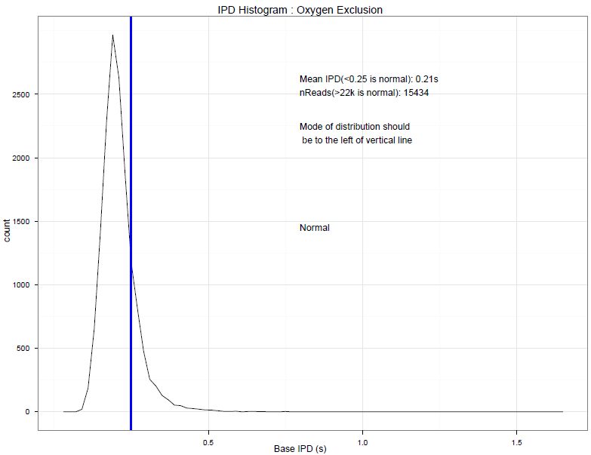
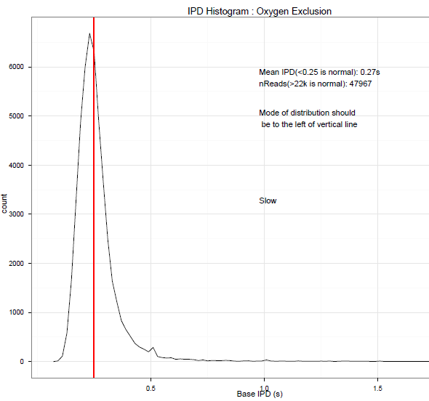
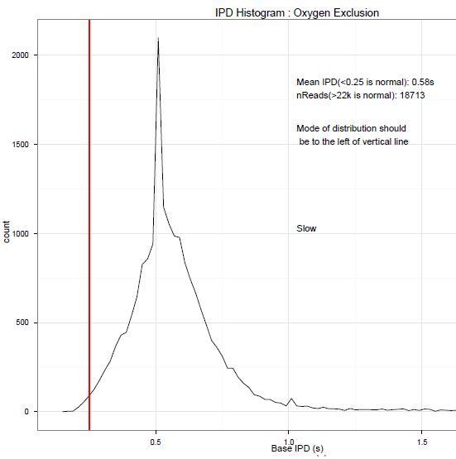
IPD Histogram: Oxygen Exclusion
Out-of-spec inter pulse distances (IPDs) indicates that oxygen was present in the system during sequencing.

Slide 21
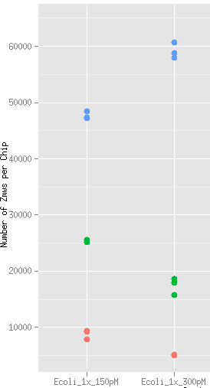
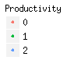
Distinguishing Between Similar Phenotypes with stsPlots
The stsPlots tool can be used to distinguish between different sample prep problems.
High prod=2 does not necessarily mean ‘overloading’
ZMWs are prod=2 if they have pulse activity and the base rate is significantly higher than for high quality sequencing.
Free polymerases bound to the bottom of a ZMW generate reads that are binned as prod=2, as they sample dye-linked nucleotides during sequencing.
When using productivity values to troubleshoot, always focus on the prod=1 and prod=0 counts as well as which is higher.
At left, overloading (300 pM) does increase the number of prod=2 ZMWs, but it is better to focus on low number of prod=1 and prod=0 ZMWs, and the fact that there are more prod=1 than prod=0 ZMWs.
Overloaded

Slide 22
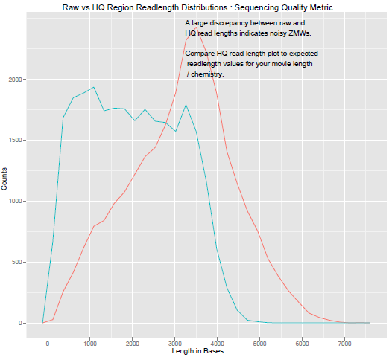
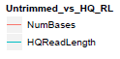
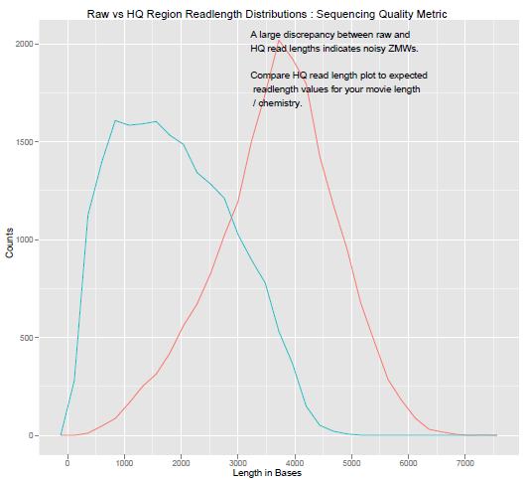
Optimal vs Overloaded Chips (C2 Chemistry)
Good
The discrepancy between raw and HQ readlengths increases as more of the activity in each ZMW is filtered out due to (in this case) overloading.
Overloaded

Slide 23
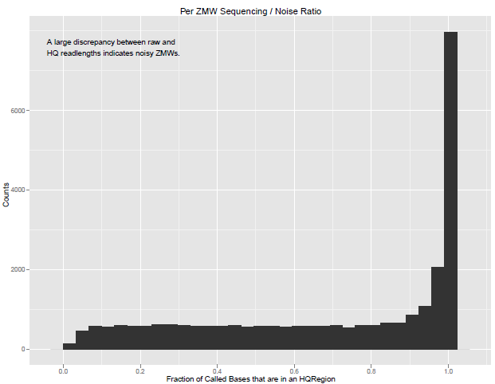
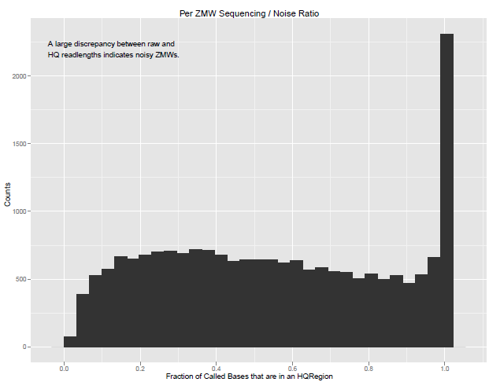
Optimal vs Overloaded Chips (C2 Chemistry)
Good
Overloaded
More and more ZMWs have a low proportion of called bases located inside HQ regions due to (in this case) overloading.

Slide 24
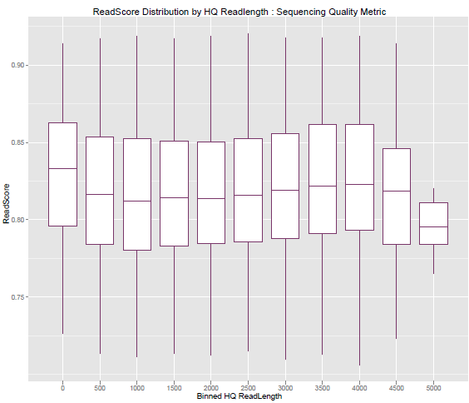
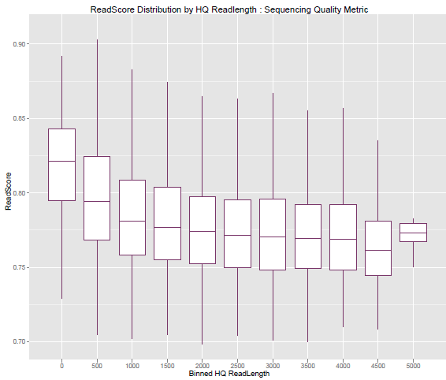
Optimal vs Overloaded Chips (C2 Chemistry)
Good
Overloaded
Readscore drops for overloaded chips, but is often higher in the shortest readlength bins because greatly shortened HQ regions have captured parts of the trace where only one polymerase was active.

Slide 25
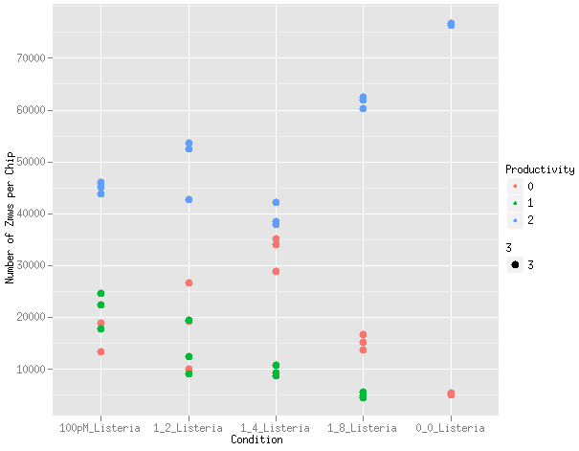
Another Common Phenotype: Excess Free Polymerase
A series of binding tubes were made with the same amount of polymerase but decreasing amounts of SMRTbell, all the way down to no DNA. (6 kb library)
As a result, the samples have increasing amounts of free DNA polymerase from left to right.
Just like overloading, free polymerase gives a high prod=2 phenotype. It is more useful to note that excessive free polymerase leads to very few prod=1 ZMWs, and that the prod=0 count matches or exceeds the prod=1 count.

Slide 26
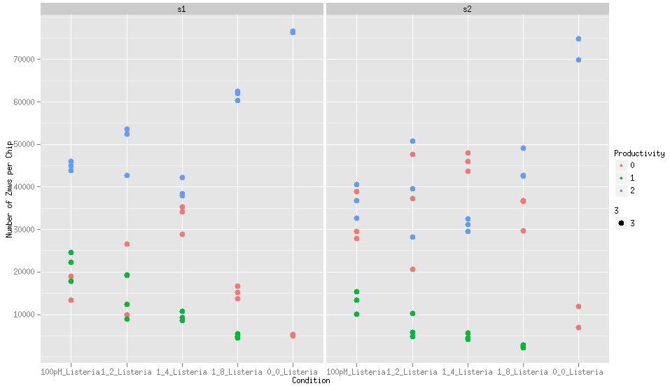
Comparison of Set1 and Set2 with Excess Free Polymerase
In the second set, prod=1 ZMWs do not increase, as they would with overloading: when the free polymerases die out, these wells turn from prod=2 to prod=0, not to prod=1. Unlike with true overloading, there is no active complex in these prod=2 ZMWs.

Slide 27
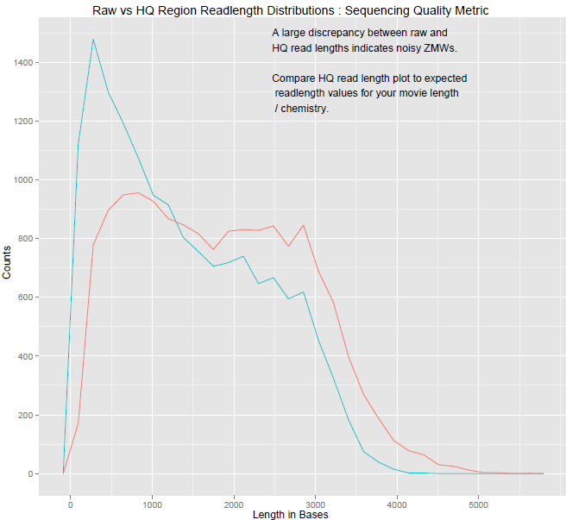
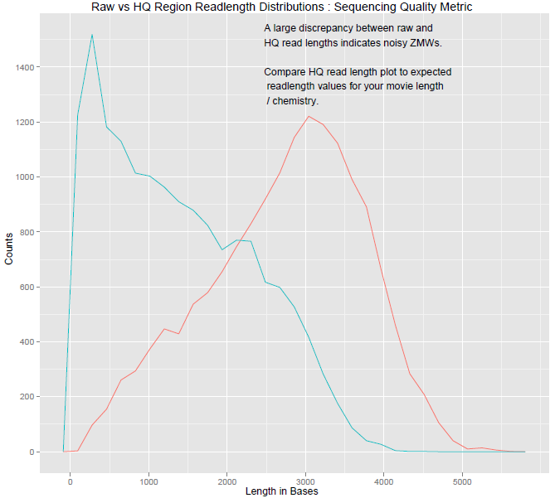
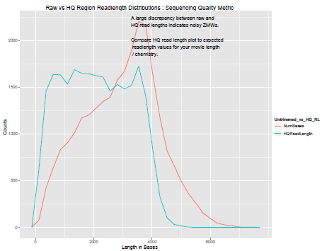
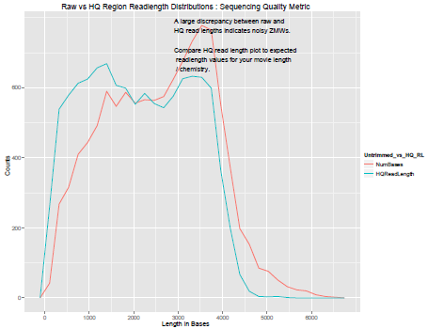
The Phenotypes Can be Distinguished Using Additional Plots
More active complex
Overloading with active complex leads to the trimming of reads to exclude low quality regions; excess free polymerase does not.
Free polymerase creates random single pulses along the whole trace as the enzyme samples free analogs.
Multiple sequencing complexes result in continuous, excludable sections of low quality, which end when one complex stops either from photodamage, dissociation, or pausing.
optimal loading
overloaded
More free polymerase
100pM_Listeria
1_8_Listeria

Slide 28
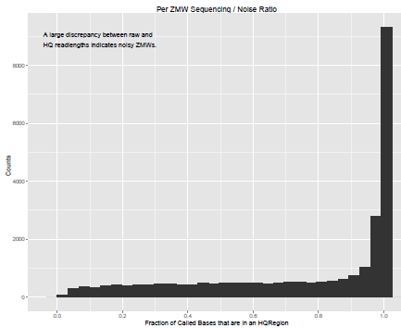
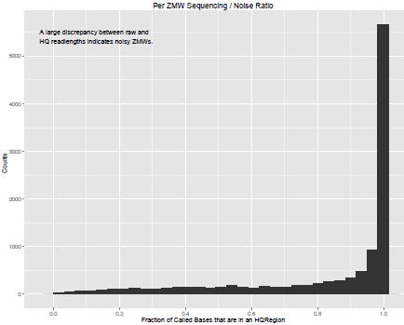
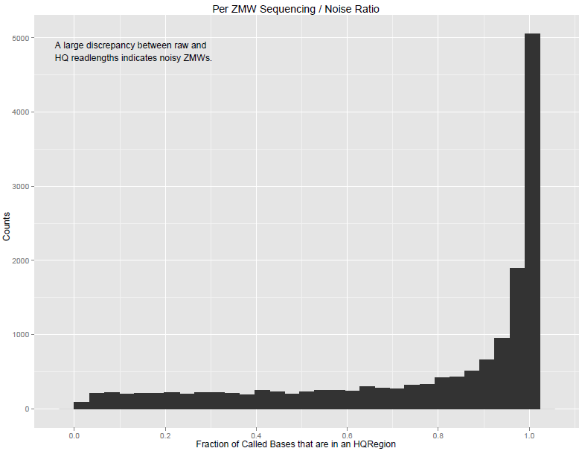
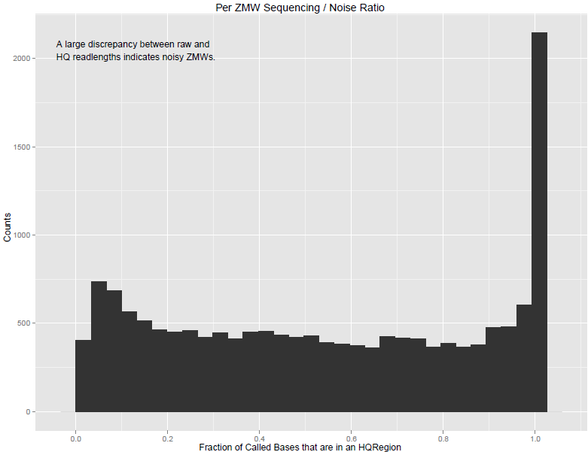
A Related Plot Also Helps Distinguish the Two Phenotypes
Overloading with active complex leads to a lower proportion of called bases inside HQ regions; excess free polymerase does not.
Note that overloading can be fixed by reducing the concentration of complex on the plate;
Excess free polymerase cannot!
100pM_Listeria
1_8_Listeria
More free polymerase
optimal loading
overloaded
More active complex

Slide 29
Phenotypes and Possible Root Causes
High Prod=2 and low Prod=1
Prod=0 <= Prod=1
Large discrepancy in RL distribution between Called Bases and HQRegion
Significant proportion of called bases are outside of HQ region
High Prod=2 and low Prod=1
Prod=0 >= Prod=1
Little shift in RL distribution between Called Bases and HQRegion
Nearly all called bases are in HQRegion
Overloading
Reduce the concentration of complex on the plate.
Under quantitation of DNA leads to too much polymerase in the binding step
Make a new binding tube.

Slide 30
Questions About or Problems with stsPlots
Email Customer Support
Send
The exact command you used to execute stsPlots.batch.R (copy/paste or screen shot preferred)
The error message output onto your screen
The sts.csv file that failed

Slide 31
Summary of Key Points
Key Points
The stsPlots tool allows for rapid assessment of RS run quality.
The generated plots allow the user to diagnose:
sample overloading
excess free polymerase in the sample
poor oxygen exclusion during the run
poor chip alignment
Where to Find More Information
The most up to date stsPlots scripts can be downloaded from GitHub.
https://github.com/PacificBiosciences

